Slide 1
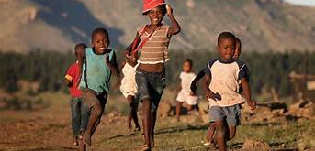
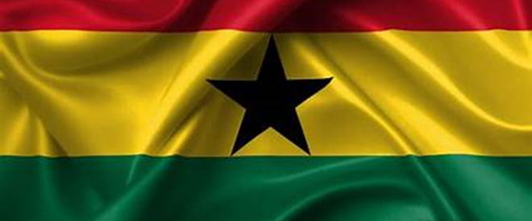

Global Outreach Centers

Slide 2
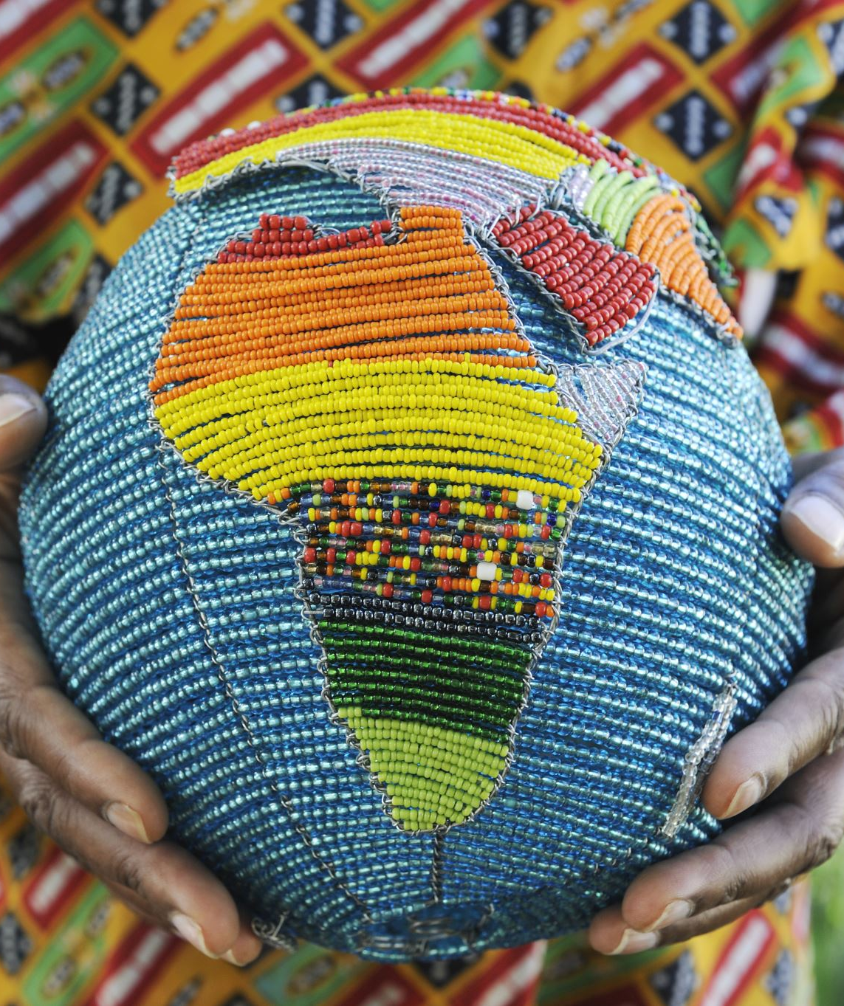
I-DIEM Africa
The Institute for Diversity and Inclusion in Emergency Management (I-DIEM) is proud to announce the establishment of a Global Outreach Center in Ghana, West Africa. Climate change has wide-ranging and significant impacts on the African continent. As a region highly vulnerable to climate-related challenges, Africa faces various consequences, affecting its environment, societies, economies, and overall development. I-DIEM will continue its community centered mission to empower and promote Community Crafted Resilience Solutions (CCRS) within Africa.

Slide 3
Community Crafted Resilience Solutions
I-DIEM supports climate equity, also known as climate justice, which refers to the fair and just distribution of the costs and benefits of addressing climate change and its impacts.
It recognizes that the historical and current contributions to greenhouse gas emissions and vulnerability to climate impacts are unevenly distributed across countries, regions, communities, and social groups.

Slide 4
Climate Change in Africa
Certain populations and countries are more vulnerable to the effects of climate change due to factors such as poverty, lack of resources, geographical location, and historical responsibility for greenhouse gas emissions.
At the same time, these vulnerable populations and countries have contributed relatively less to the greenhouse gas emissions causing climate change compared to more developed and industrialized nations, like the United States of America.

Slide 5
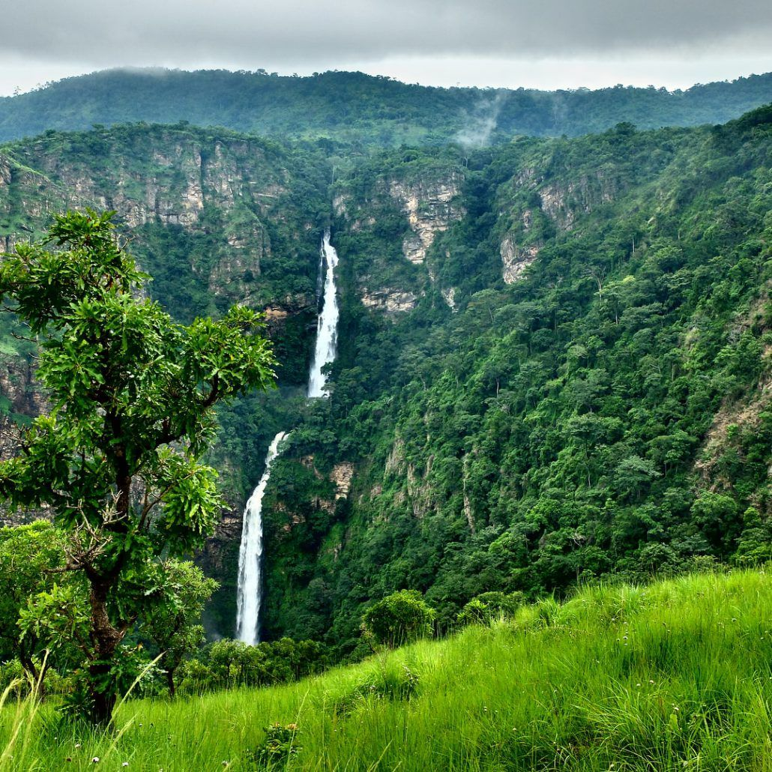
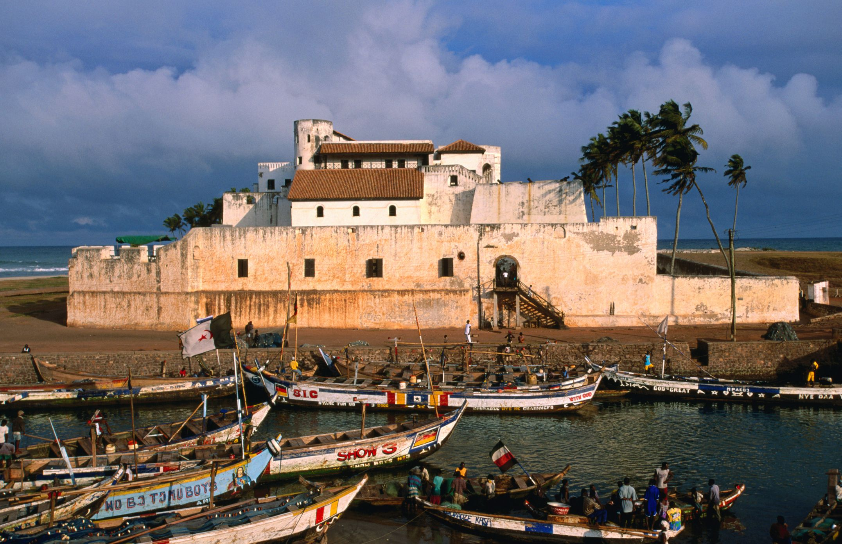
Climate Resilience
Several countries in Africa are working on various adaptation and mitigation strategies, including renewable energy, implementing sustainable land and water management practices, investing in climate-resilient infrastructure, and participating in international climate agreements.

Slide 6
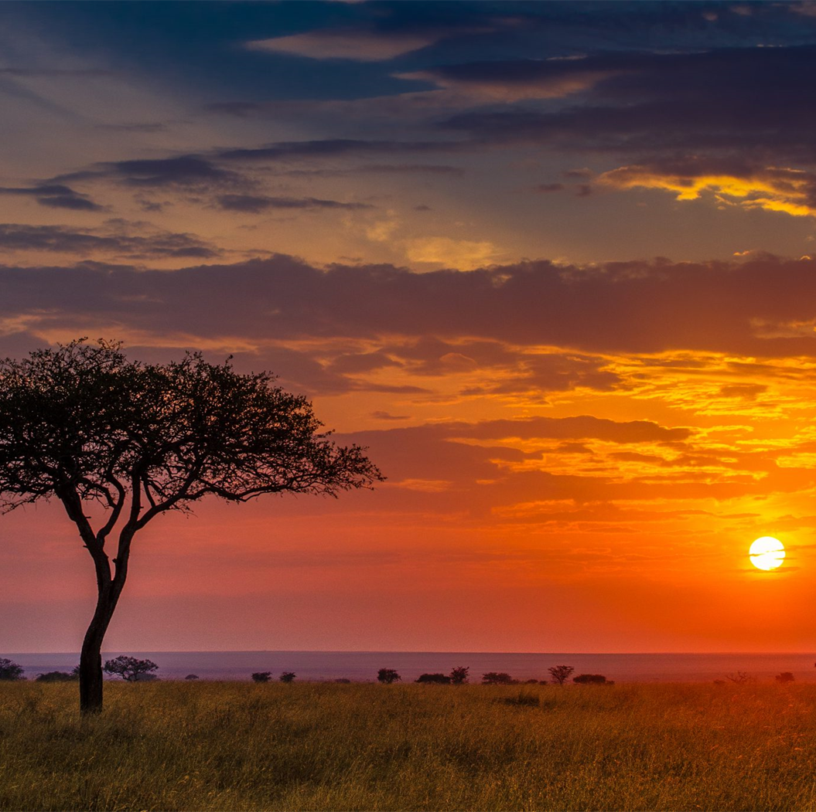

I-DIEM AFRICA
As a global organization focused on climate equity and building community resilience, I-DIEM has pledged to increase our support of African nations by establishing I-DIEM Africa to collaboratively tackle the challenges posed by climate change and ensure a sustainable future for the continent.

Slide 7
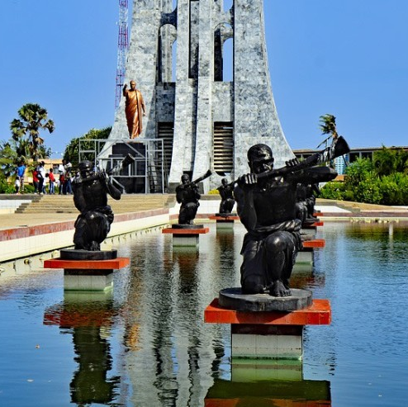
Establishing the Global Outreach Center in Ghana, West Africa
Community Impact
Government benefit
Climate resilience
Inclusive Climate Resilience

Slide 8
Funding Strategy
Government Contracts
Direct Community Investments
Grants
Domestic and International Donors

Slide 9
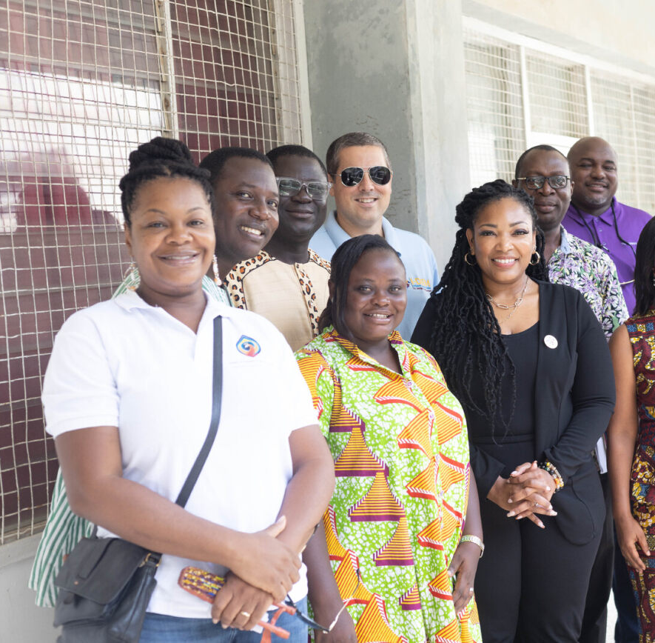
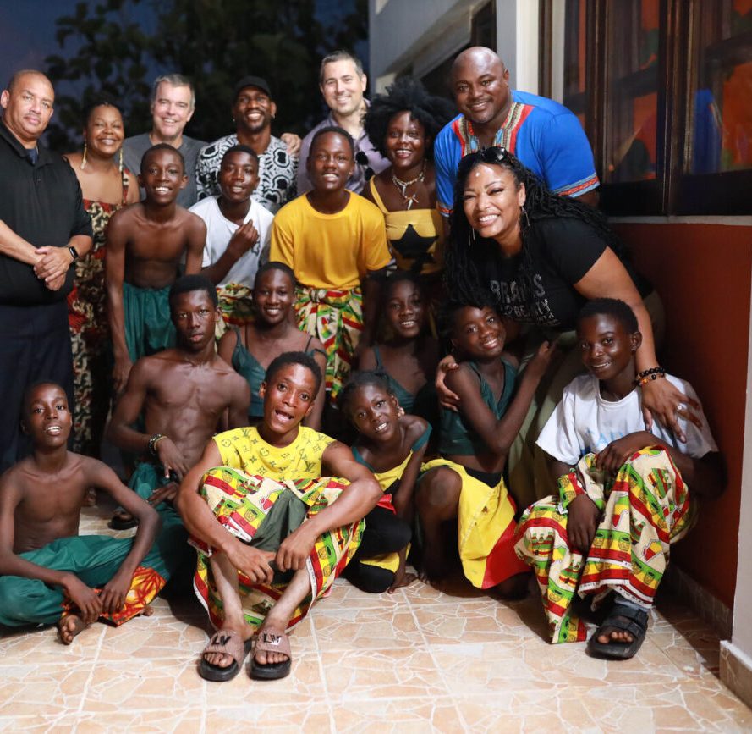
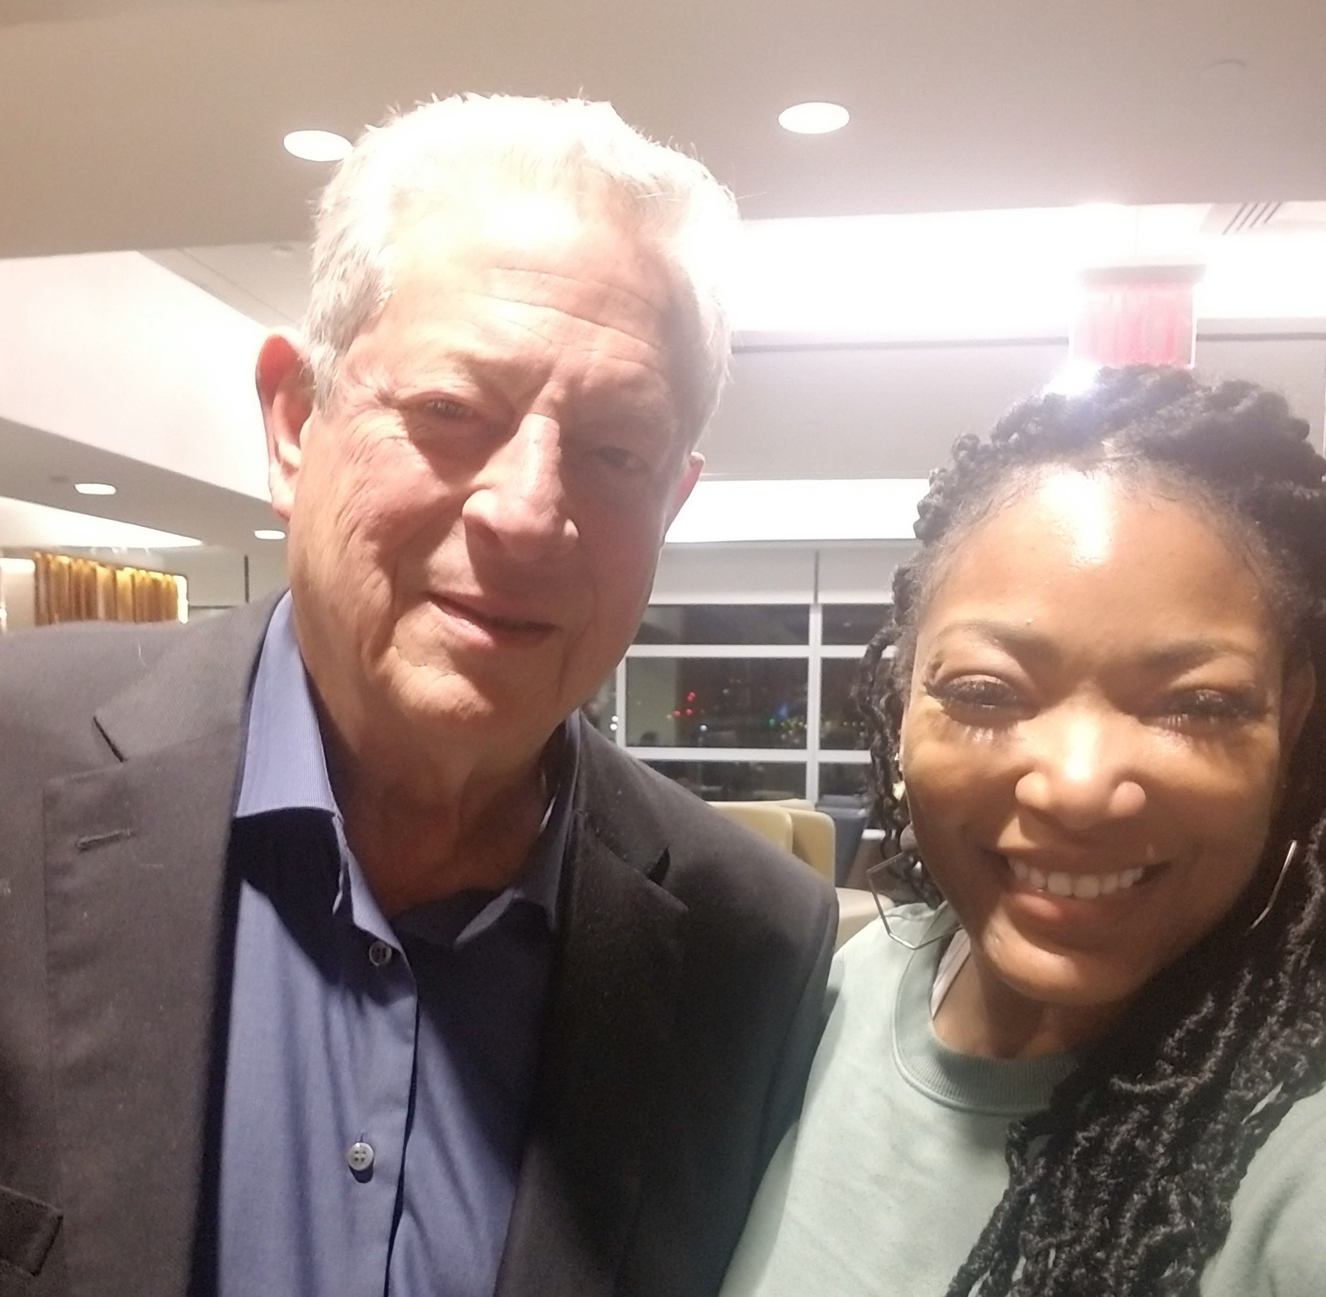

Business Established in Ghana
November 2023

Slide 10
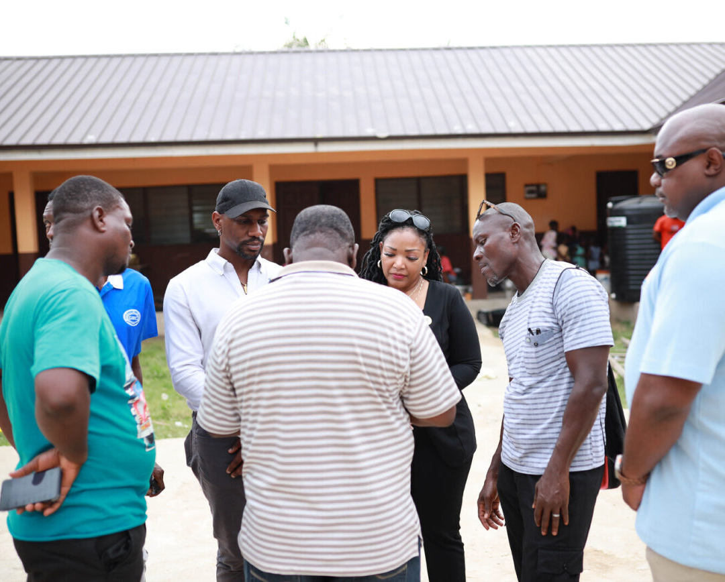
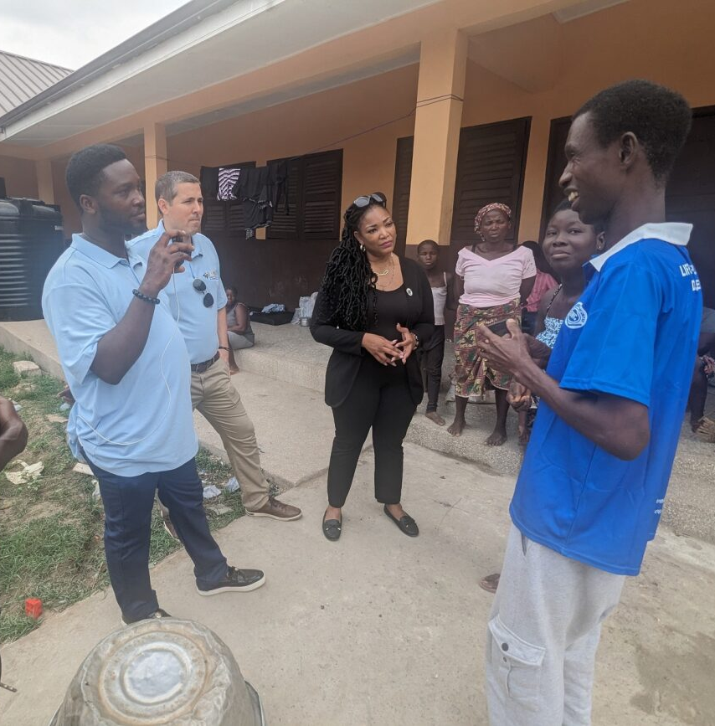
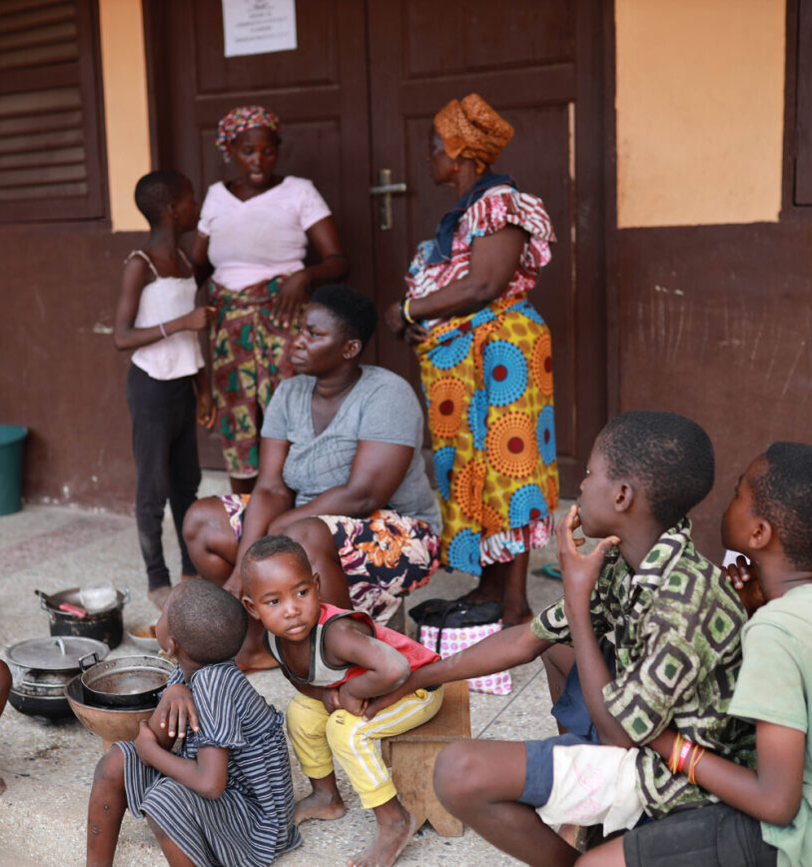

Community Engagement
North Tongu – Mepe
Akosombo Dam Site Visits

Slide 11
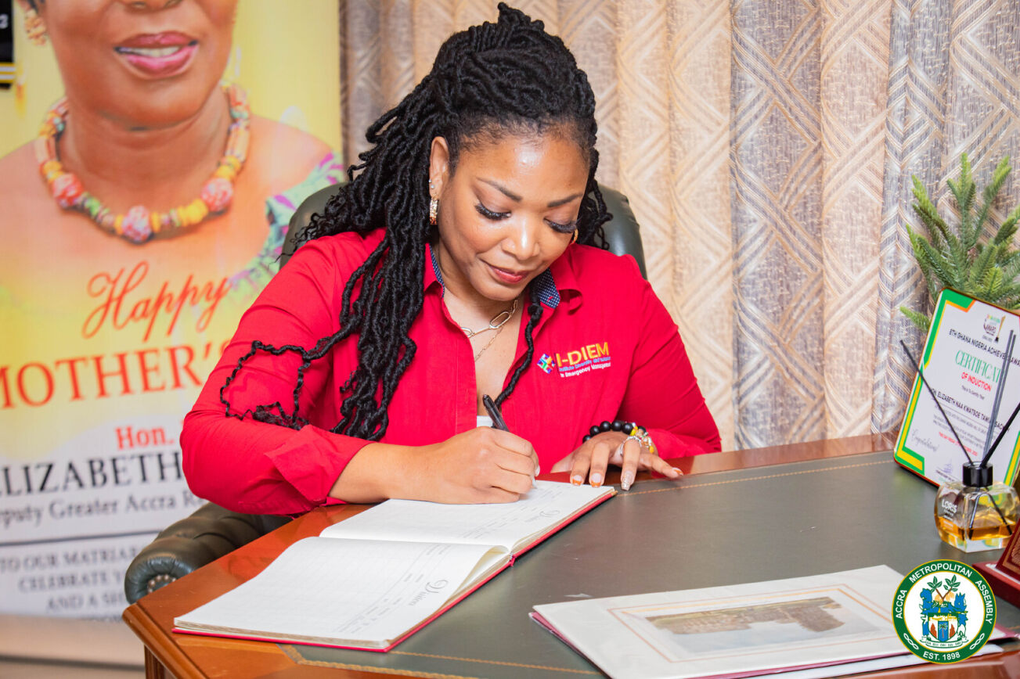
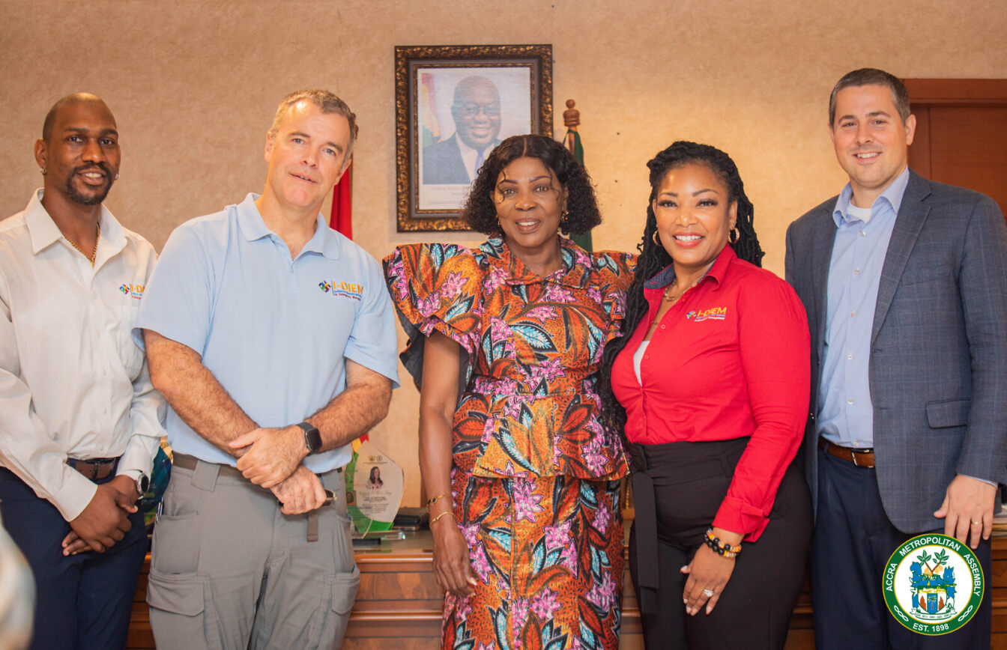
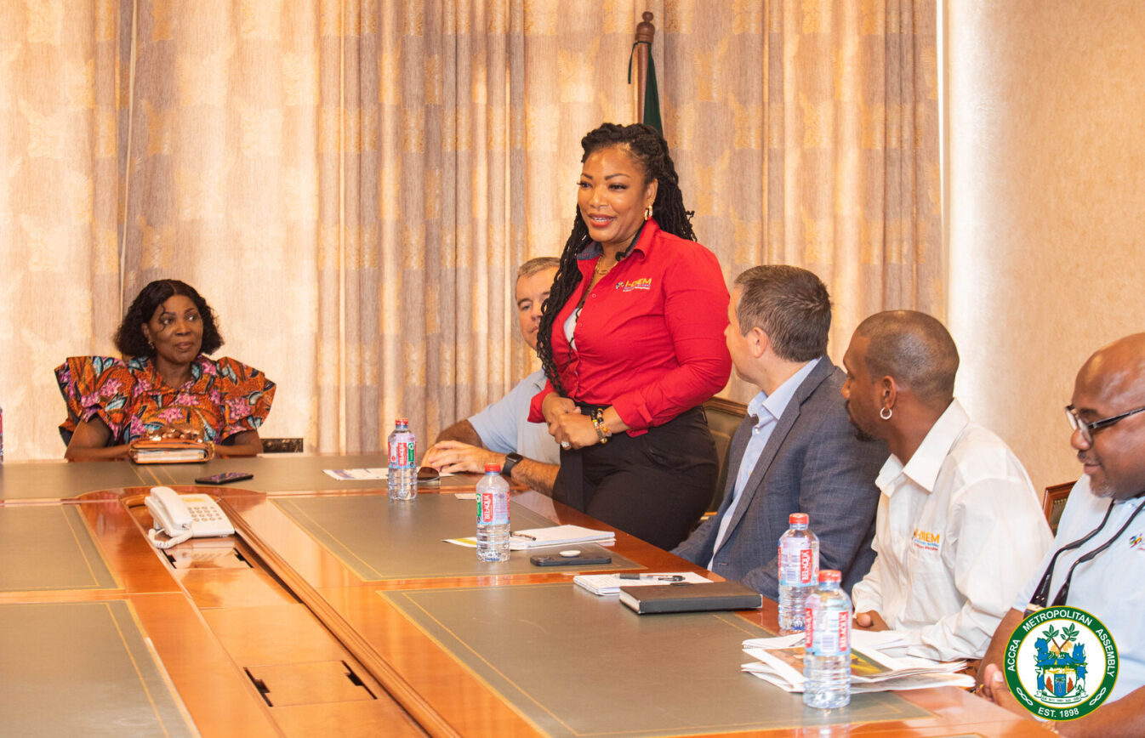
Partnership with Mayor of Accra, Ghana

Slide 12
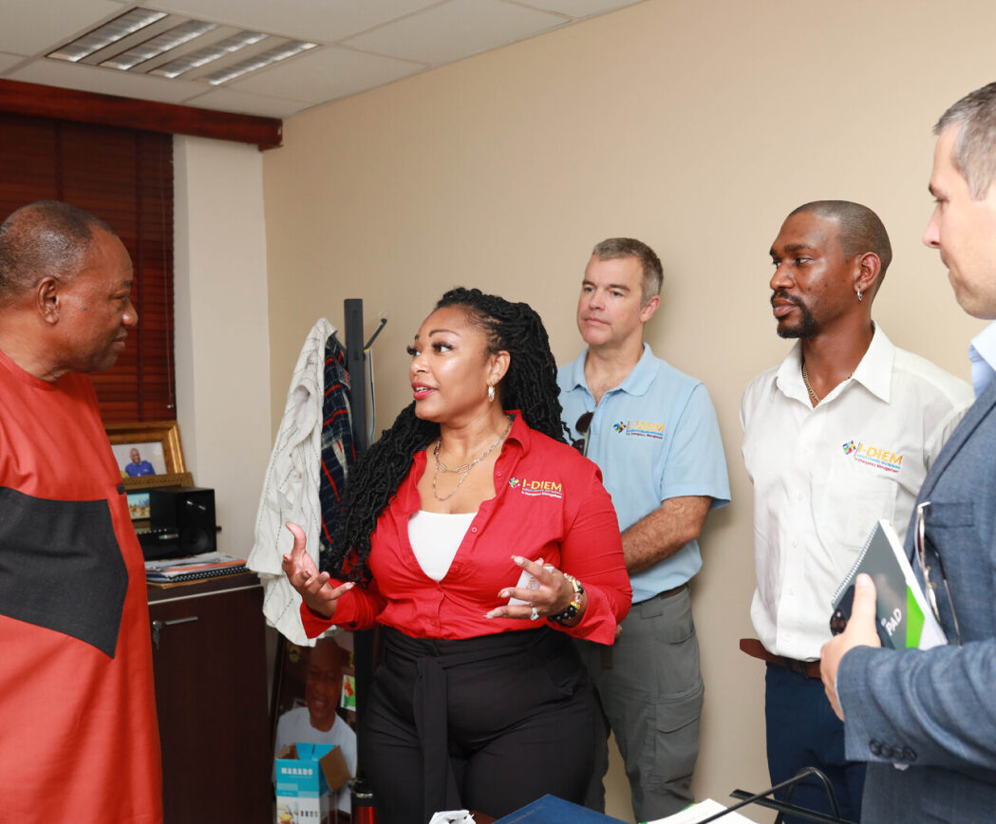
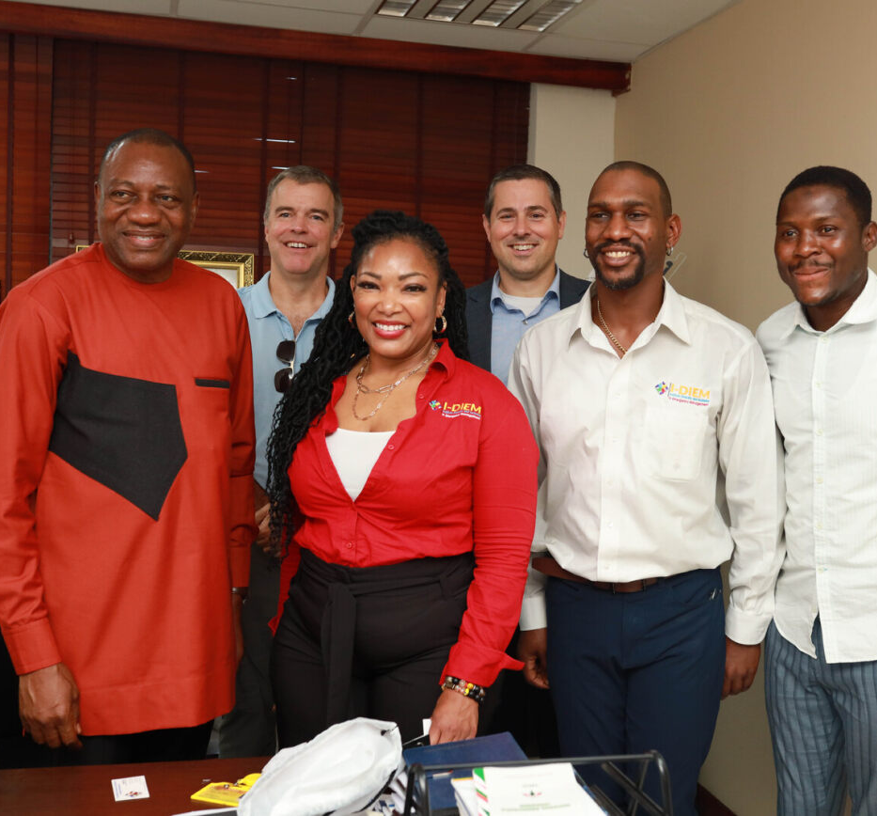
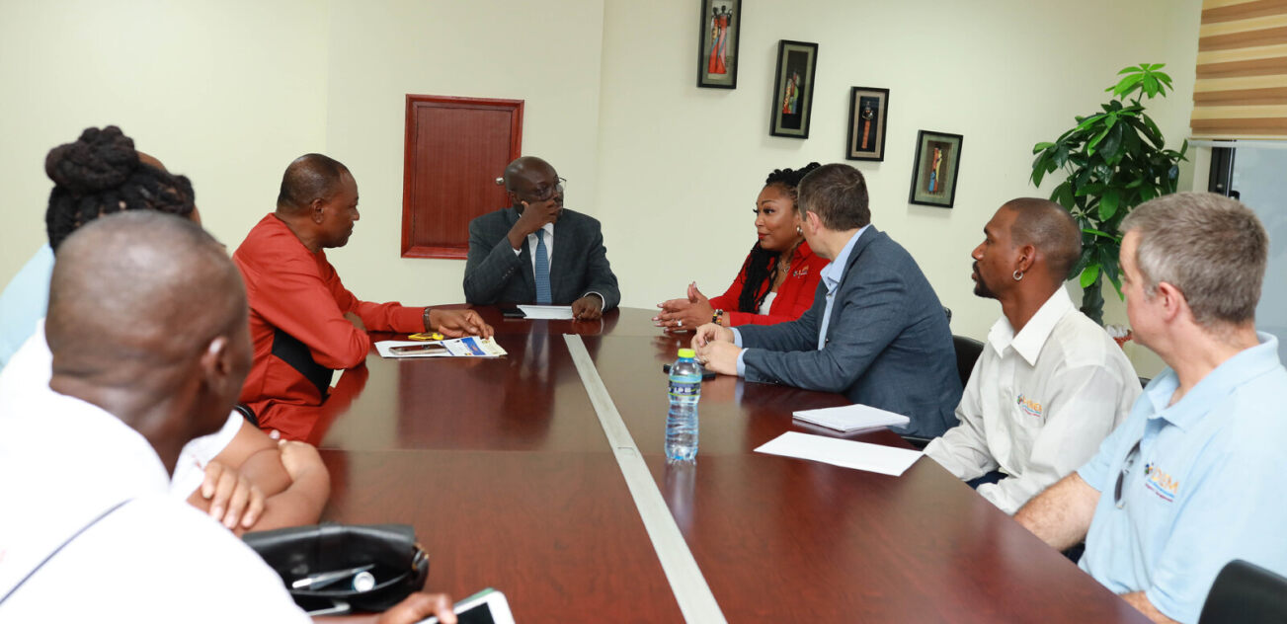
Partnership with Ghanaian Parliament

Slide 13
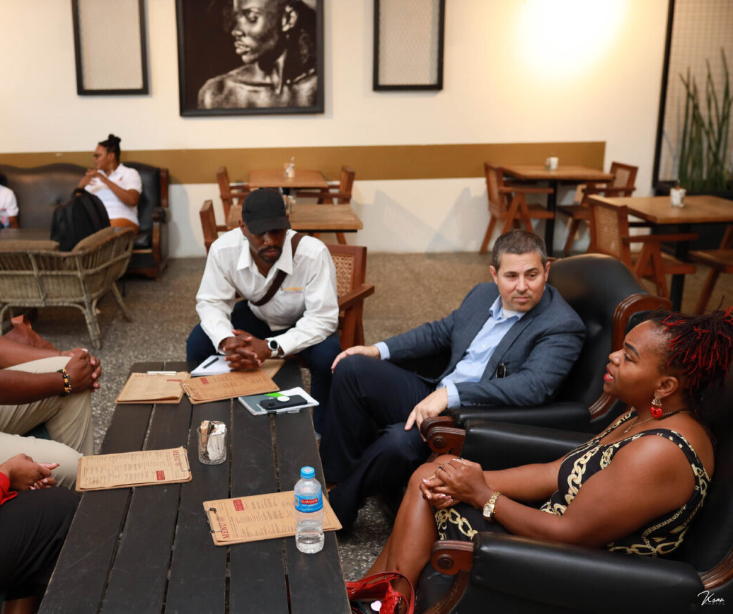
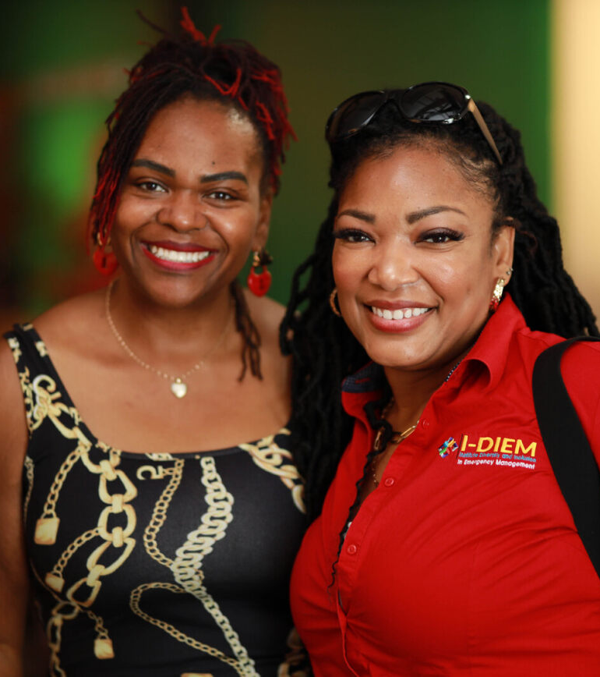
Hiring Local I-DIEM Staff in Ghana

Slide 14
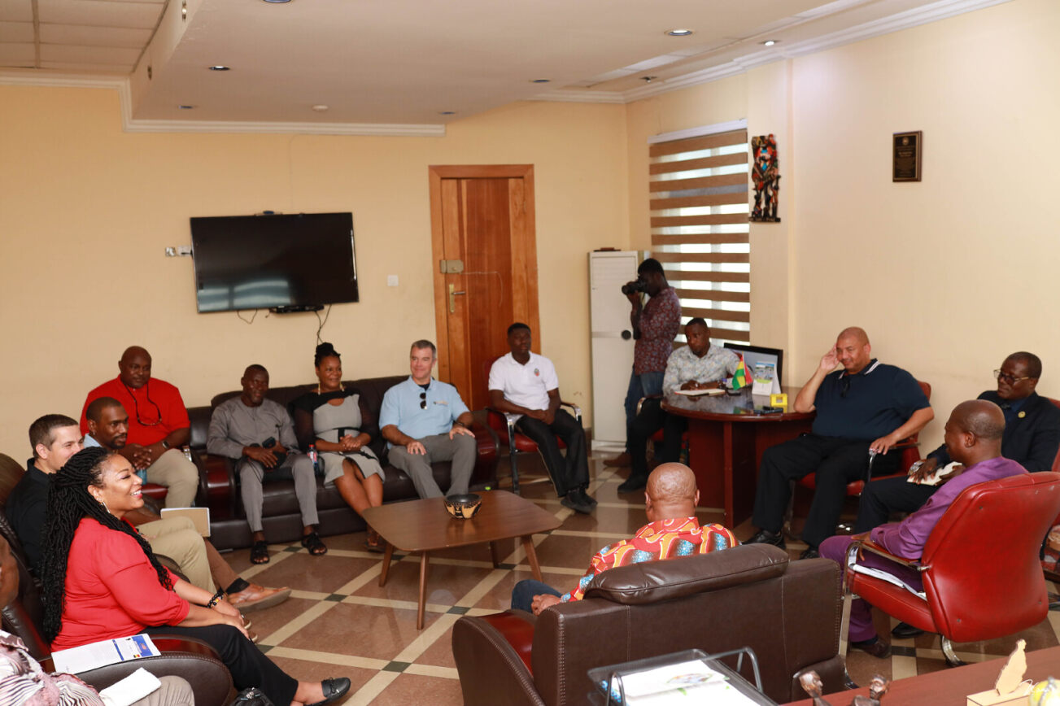
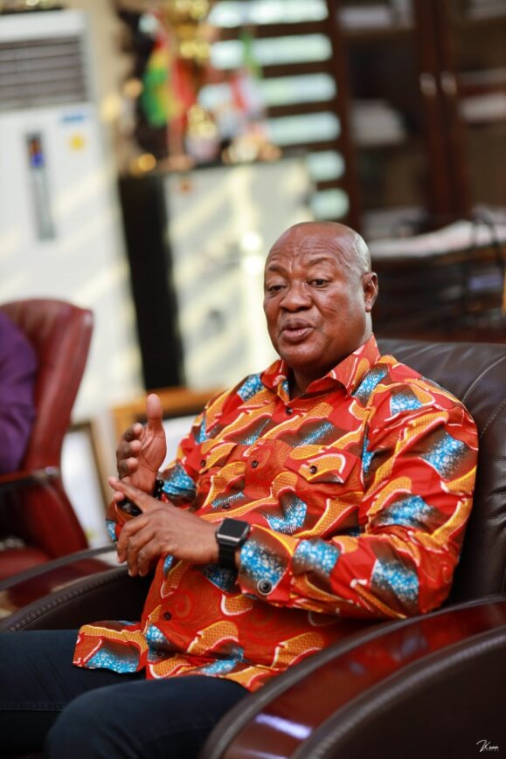
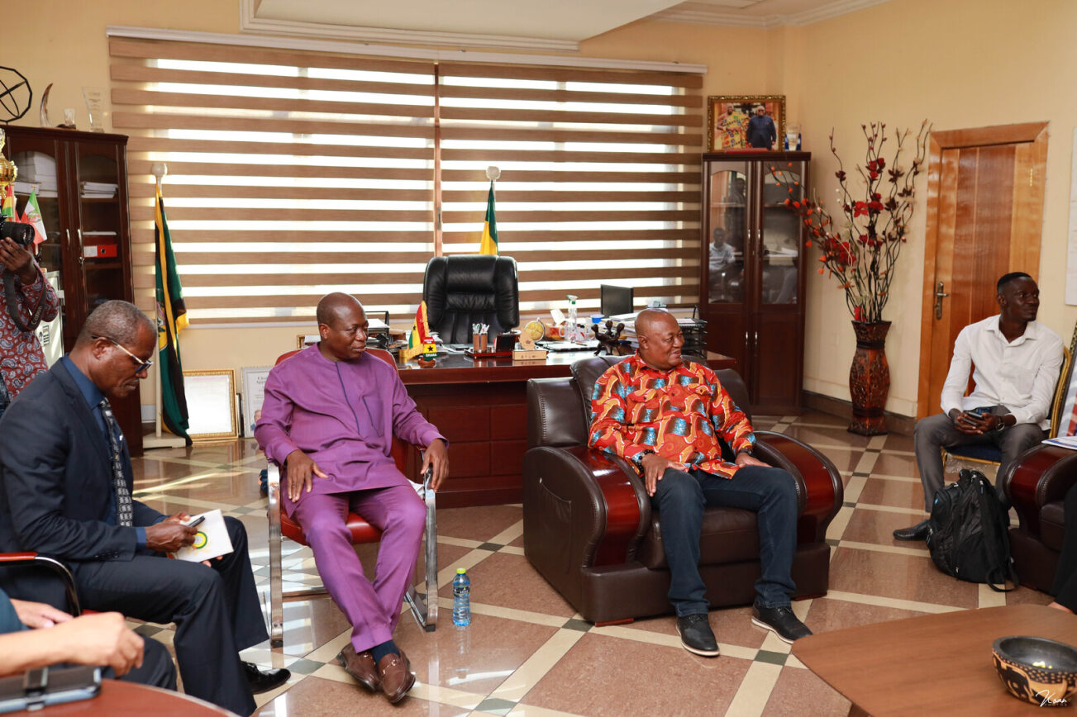

Partnership with Mayor of Kumasi, Ghana

Slide 15
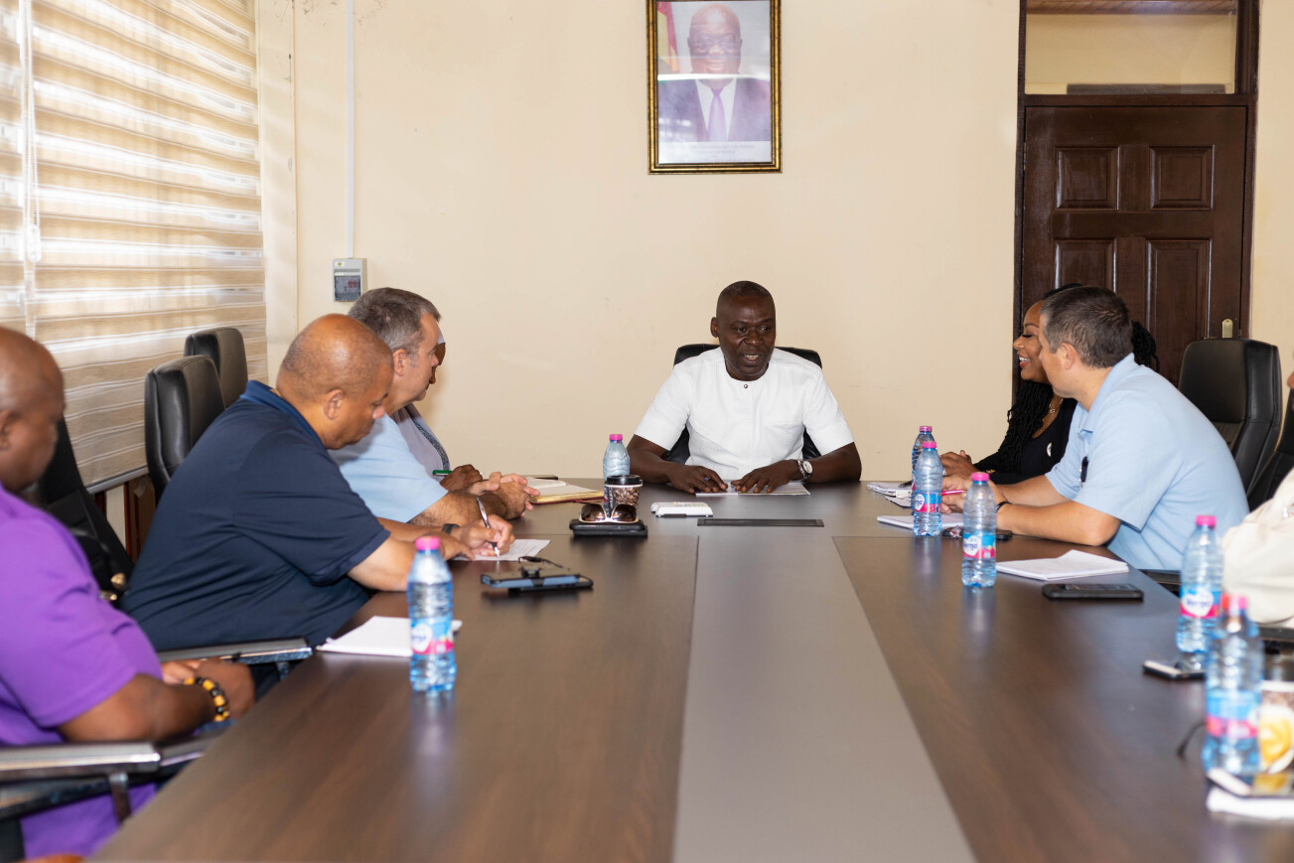
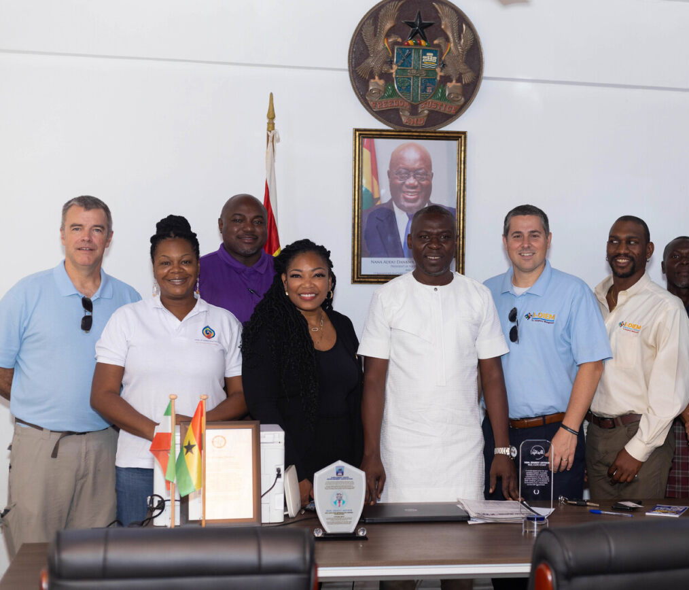

Partnership with Mayor of Cape Coast, Ghana

Slide 16
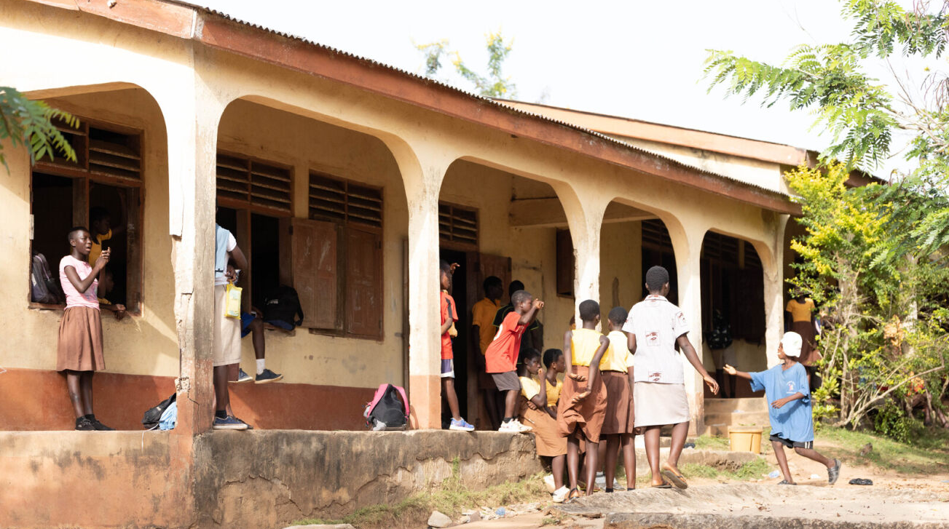
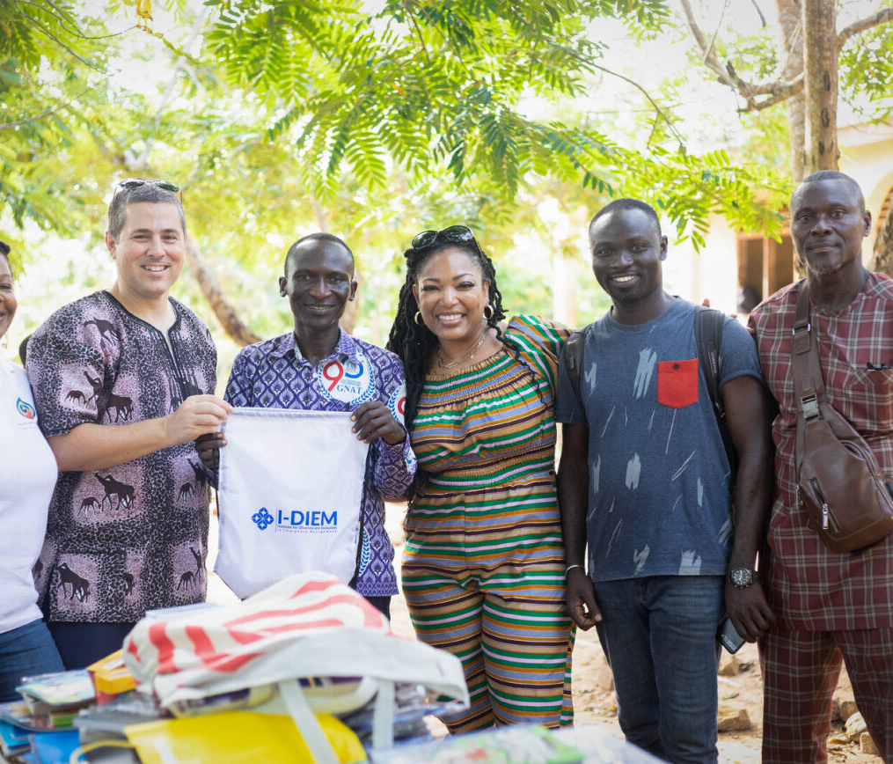
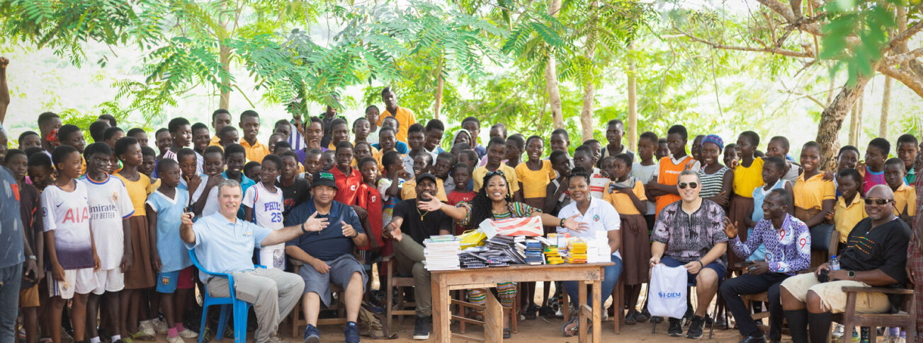
Brenu Village Tribal School

Slide 17
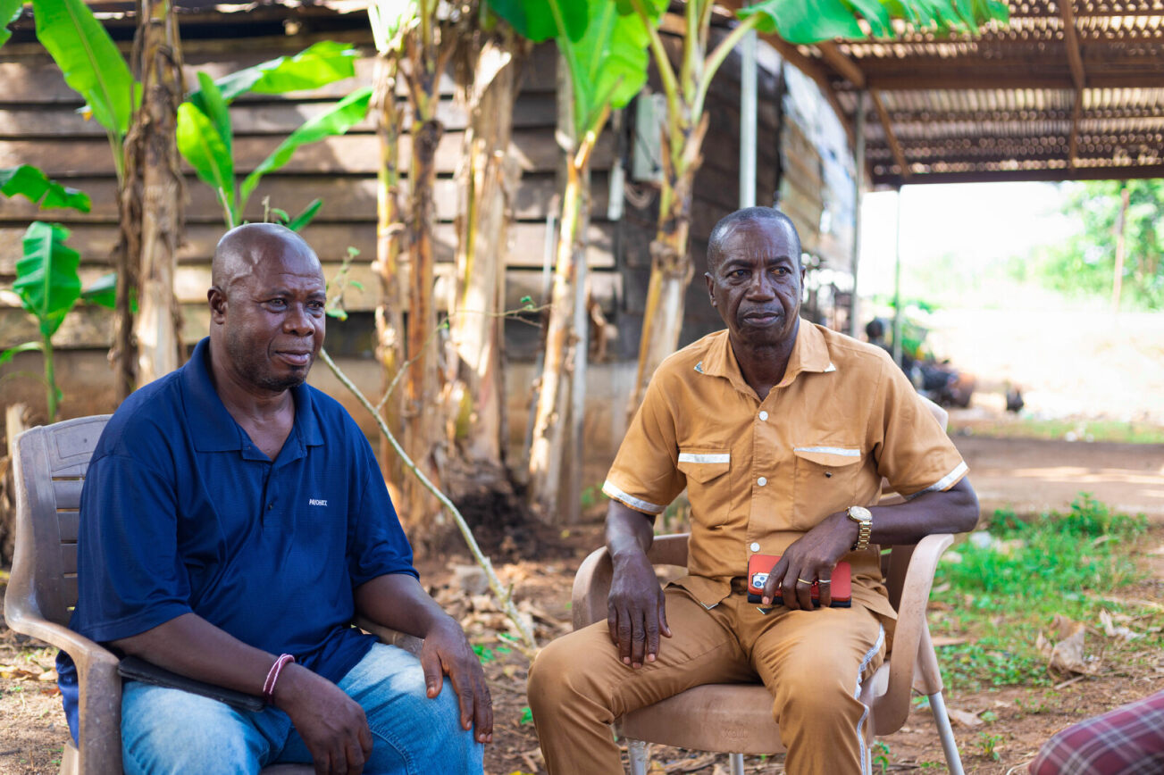
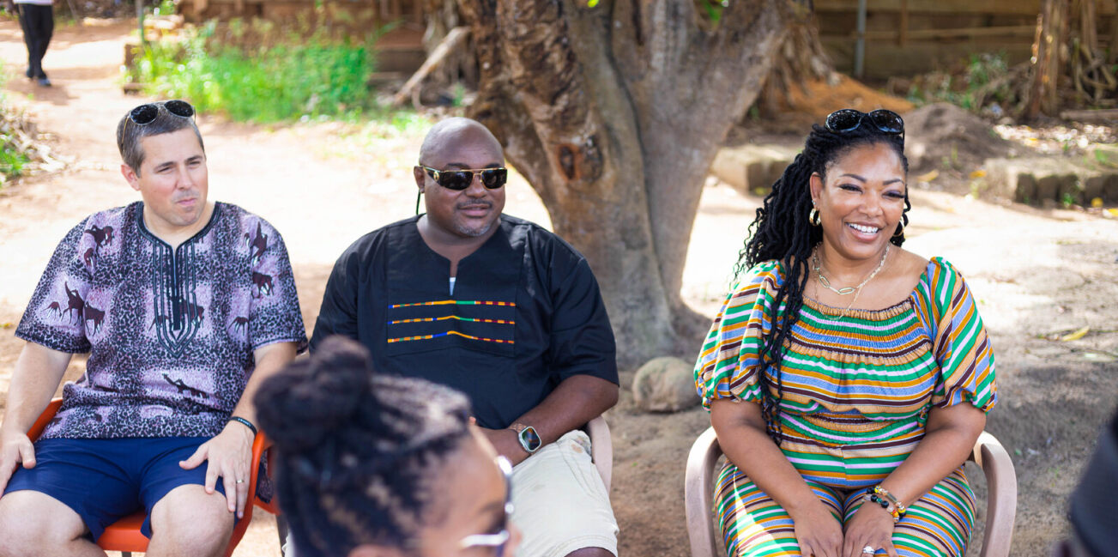
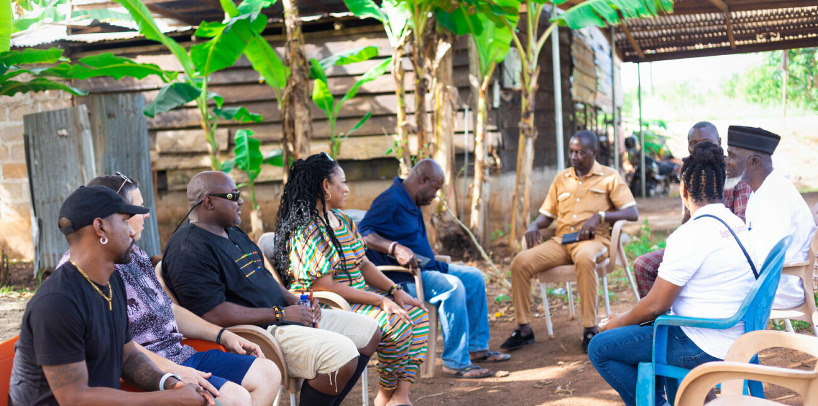
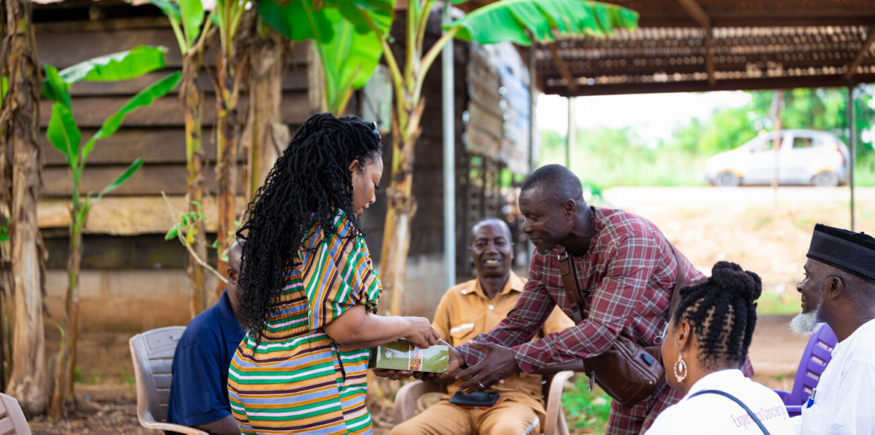
Partnership with Tribal Chief of Brenu Village in Cape Coast

Slide 18
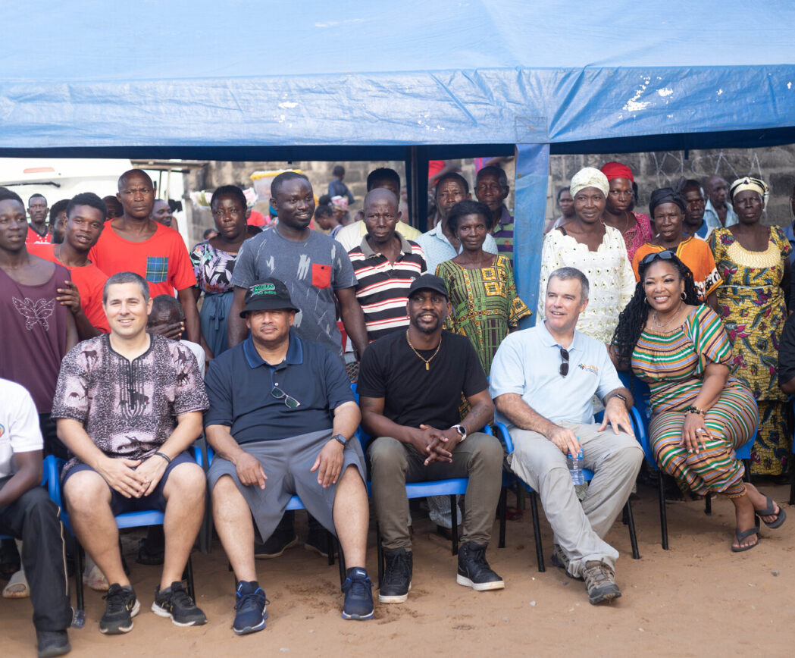
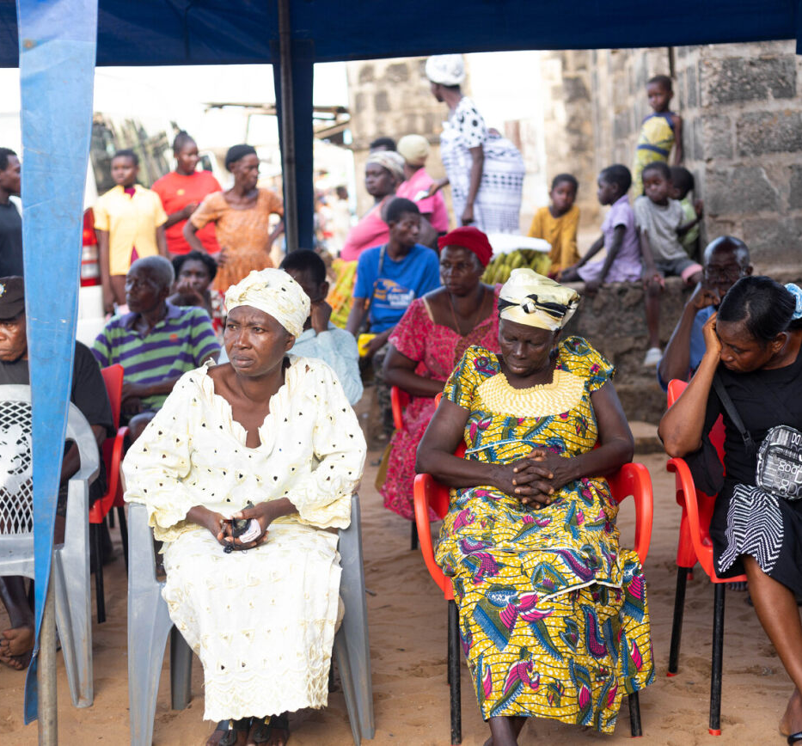
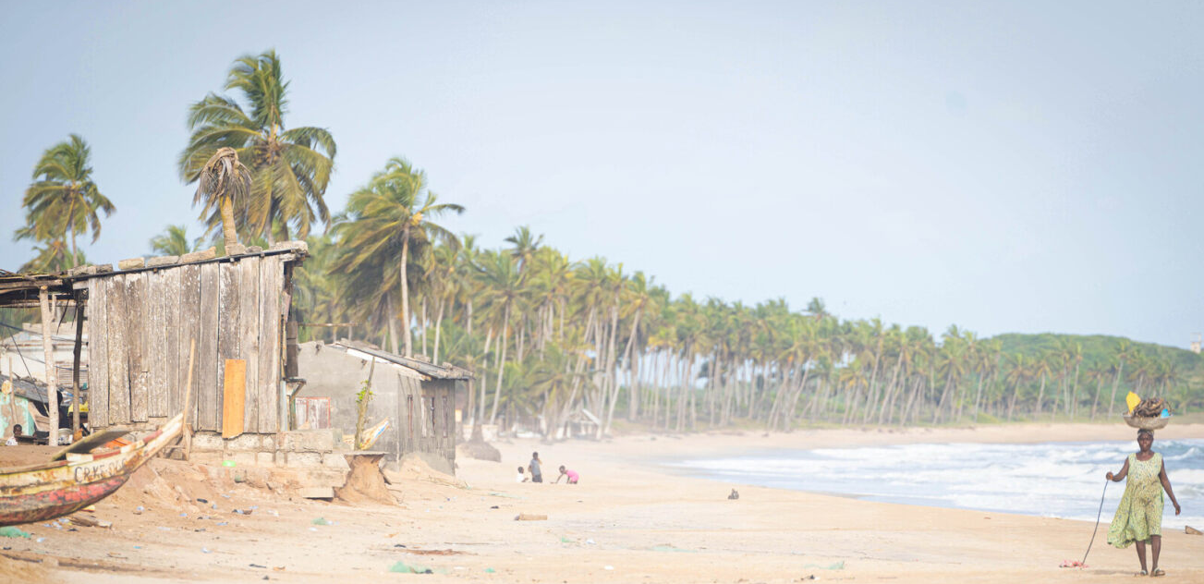

Brenu Village Climate Resilience

Slide 19
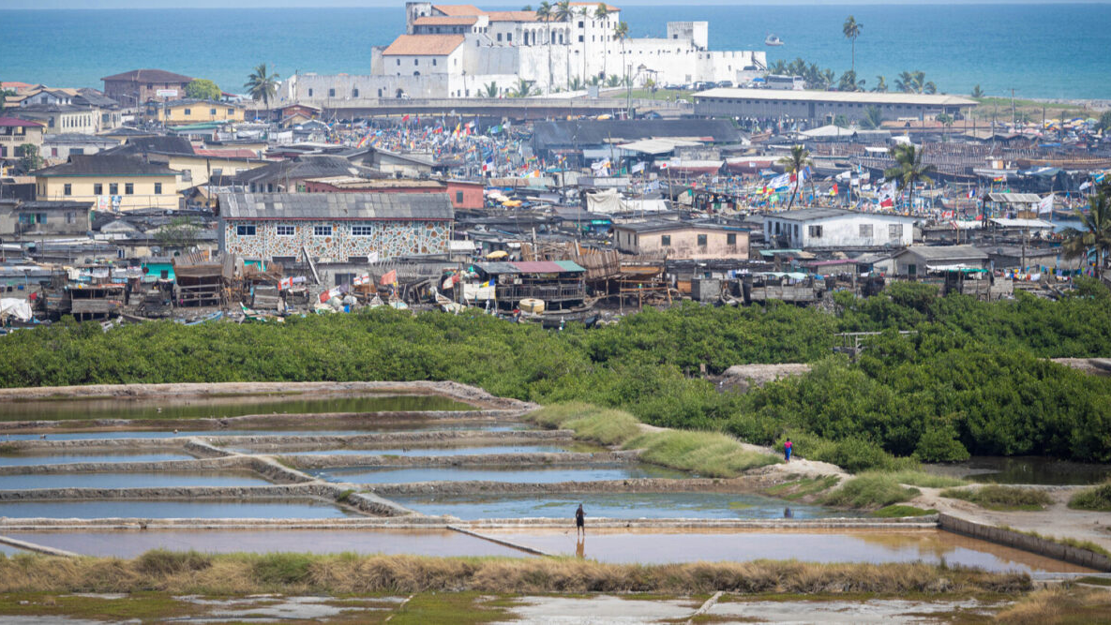
Global innovation, global impact
A climate resilience opportunity for equitable impact.

Slide 20
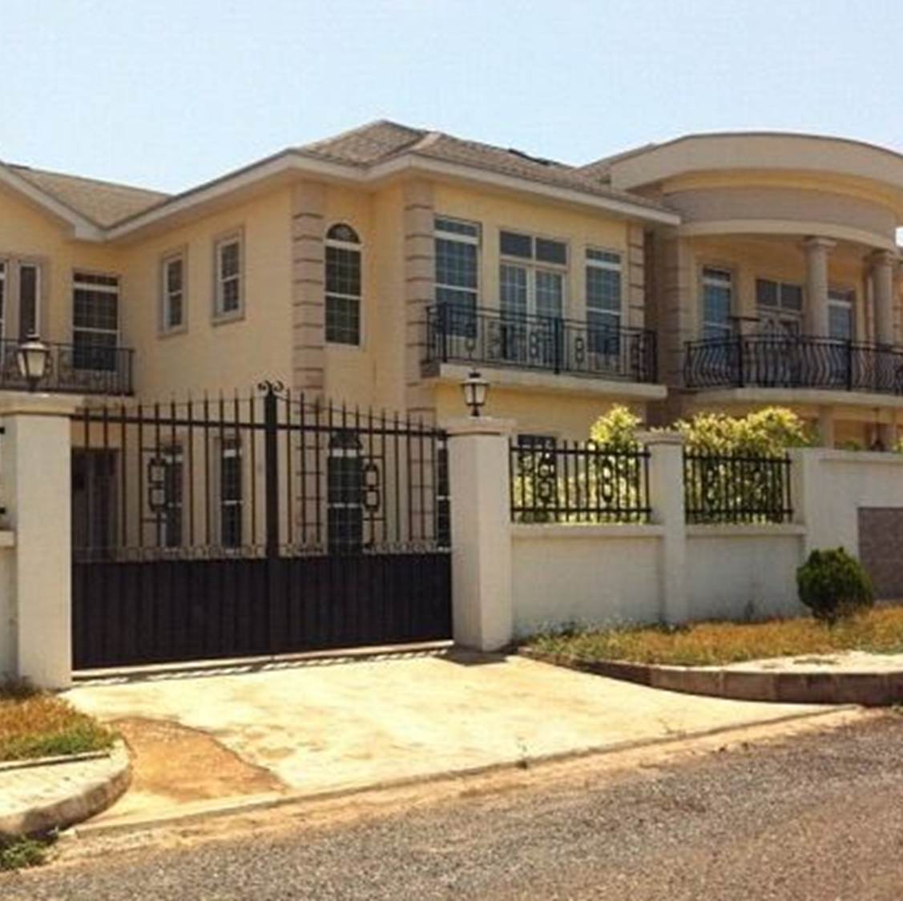
Global Outreach Center in Accra, Ghana
The Global Outreach Center in Accra, Ghana serves as the primary location for local, nation and international meeting coordination and special event hosting.

Slide 21
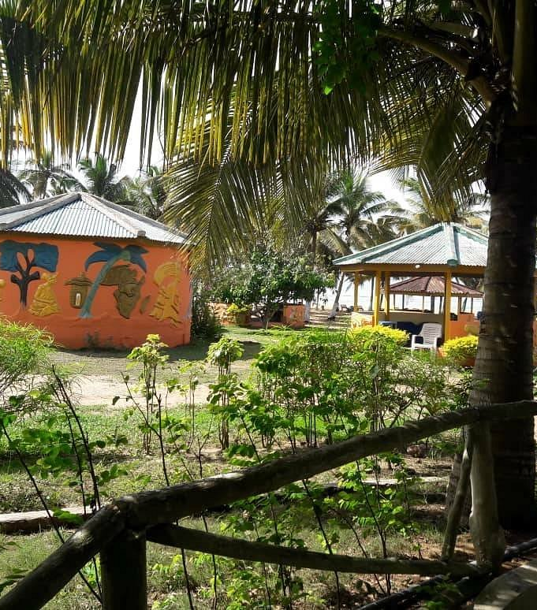
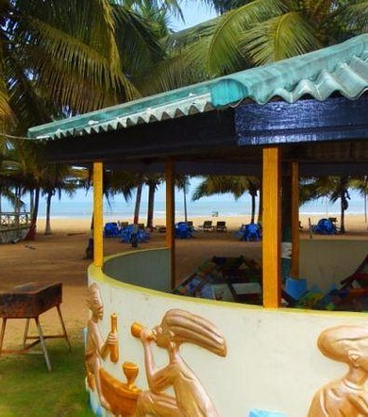
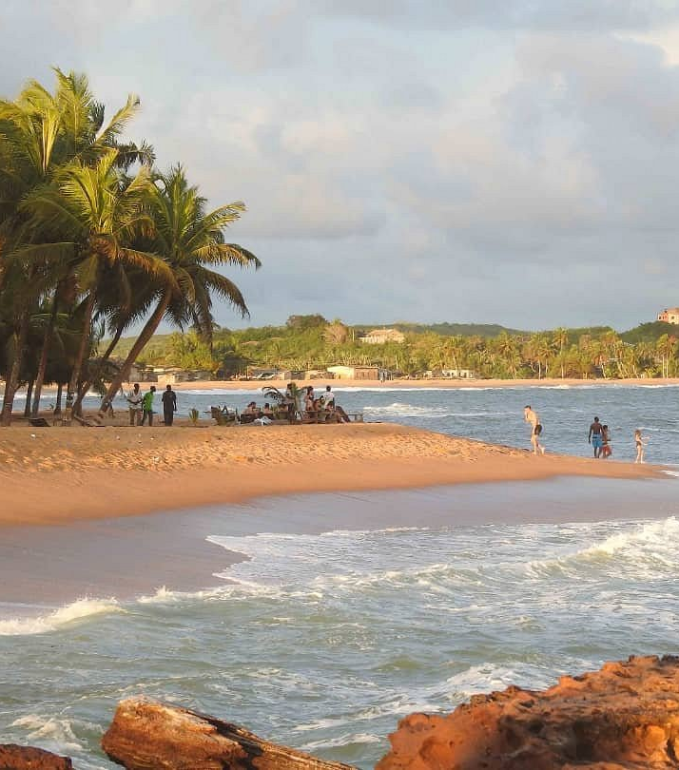
I-DIEM Africa: Ghana Resilience Innovation Lab in Cape Coast, Ghana

Slide 22
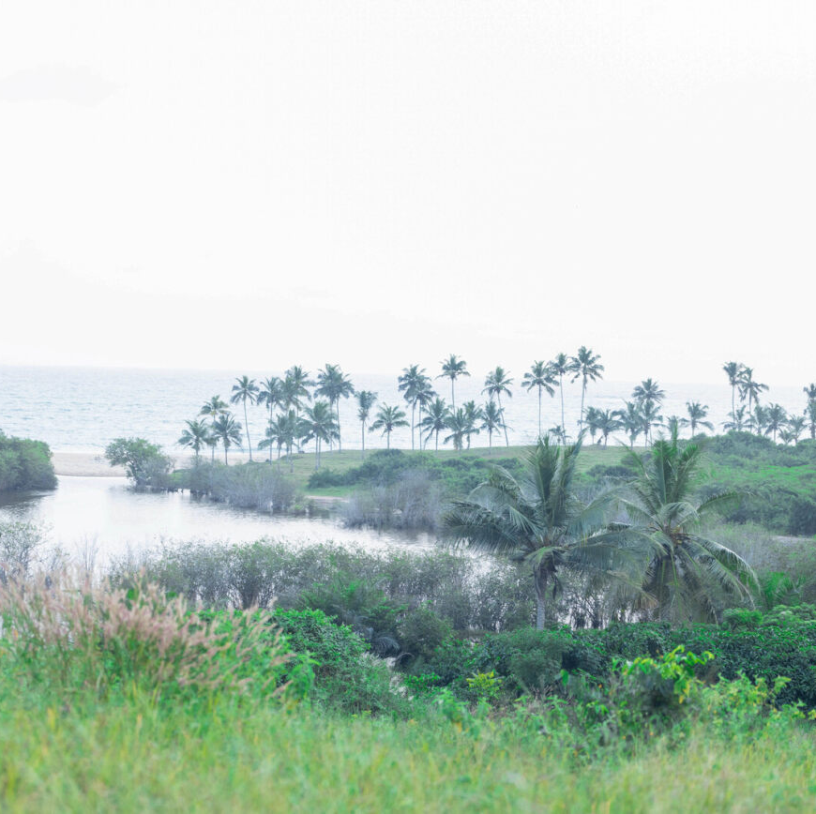
Ghana Resilience Innovation Lab
The Ghana Resilience Innovation Lab will connect and inspire people across business, civil society, academia and government to collaborate and scale up action that builds resilience to the impact of climate change and makes communities in Ghana, West Africa safer, healthier and more just.
There is an urgent need to increase the level of education and finance given to building resilience, particularly for the world’s most vulnerable populations, and placing locally informed, equitable solutions center stage.

Slide 23
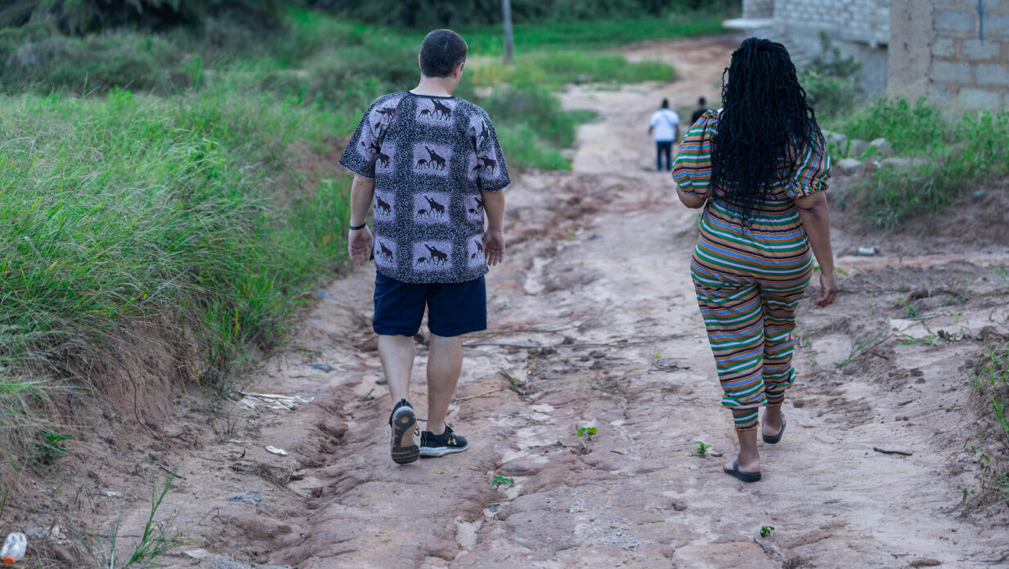
Let’s talk about how you can help!

